Slide 1
SCHOOL MANAGEMENT SYSTEM PRESENTATION
Presented by-
Subrat Jain
Aman Kumar
Sanskar Singhal

Slide 2
INTRODUCTION
Good day everyone, today we are going to present an overview of our online job portal project. As we all know, the job market has become increasingly competitive, and finding the right job can be a challenging task. To overcome this challenge, we have developed an online job portal that will connect job seekers with potential employers, making it easier for them to find suitable job opportunities. Our online job portal is designed to provide a comprehensive platform that facilitates job searching, job posting, and resume submission. The portal is user-friendly and can be accessed by anyone with an internet connection. It is designed to cater to the needs of both job seekers and employers, providing a range of features to make the job search process more efficient. In this presentation, will be outlining the goals and objectives of the project, the key features of the portal, the design and architecture of the system, the technology stack we have used, testing and quality assurance procedures, as well as the challenges we faced during the project and the solutions we implemented. I hope that by the end of this presentation, you will have a better understanding of our online job portal project and how it can benefit both job seekers and employers.

Slide 3
PROBLEM STATEMENT
Student enrollment and registration: One of the major challenges faced by schools is managing the process of student enrollment and registration. This process involves collecting student information, verifying their eligibility, and allocating seats in the appropriate classes.
Attendance tracking: Schools need to keep track of student attendance to ensure that they are meeting the minimum attendance requirements. This process involves taking attendance, recording it, and notifying parents or guardians in case of any discrepancies.
Timetable scheduling: Creating and managing a timetable for a school is a complex task that involves coordinating the availability of teachers, classrooms, and resources to ensure that classes run smoothly and without conflicts.

Slide 4
TARGET AUDIENCE
School administrators: The school management system is designed to streamline the school administration process, providing tools and features to manage student enrollment, fee collection, teacher and staff management, and academic progress tracking.
Parents or guardians: Parents or guardians can use the school management system to keep track of their child's academic progress, attendance, and communicate with teachers and school administrators.
Students: Students can use the school management system to access their academic records, view their attendance and grades, and access learning materials such as assignments and course materials.

Slide 5
FEATURES AND FUNCTIONALITY
1 Student information management: The system stores and manages all student information, including personal details, academic records, attendance, and progress reports.
2. Admission and enrollment management: The system automates the admission and enrollment process by collecting and verifying student information, assigning classes and sections, and generating admission reports.
3. Timetable management: The system creates and manages class schedules, assigns teachers and classrooms, and notifies students and teachers of changes to the schedule.

Slide 6
FEATURES AND FUNCTIONALITY
Communication management: The system facilitates communication between school administrators, teachers, students, parents or guardians, and staff through email, messaging, and announcements.
4. Communication management: The system facilitates communication between school administrators, teachers, students, parents or guardians, and staff through email, messaging, and announcements.
.

Slide 7
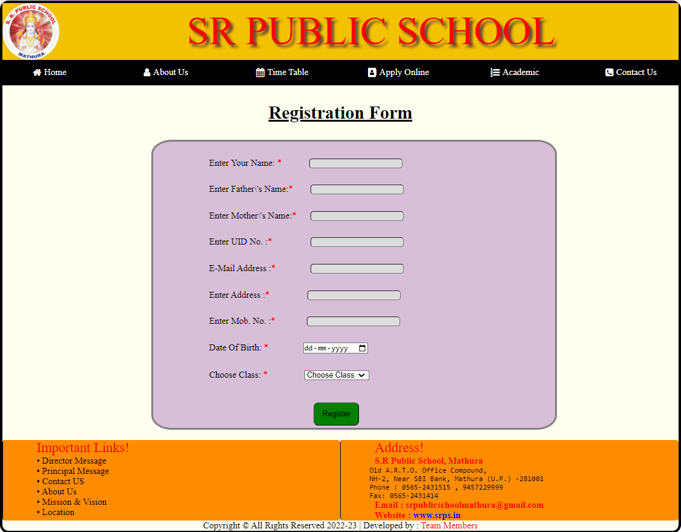
ADMIN LOGIN PAGE

Slide 8
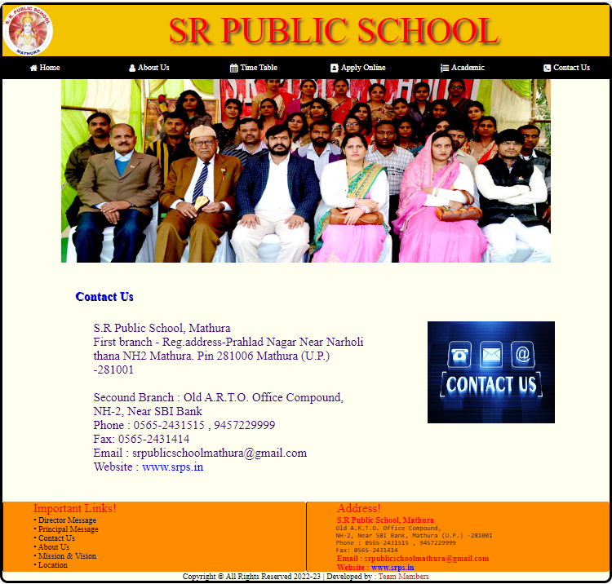
Contact us

Slide 9
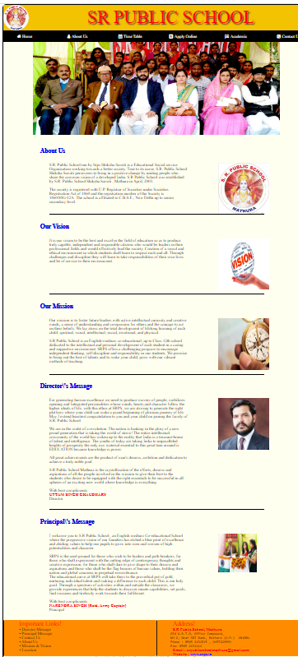
About us

Slide 10
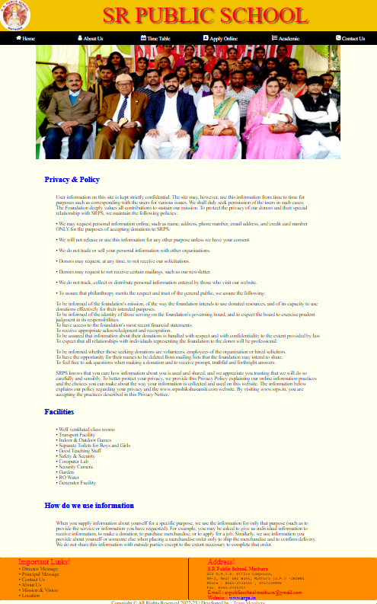
Acedemic

Slide 11
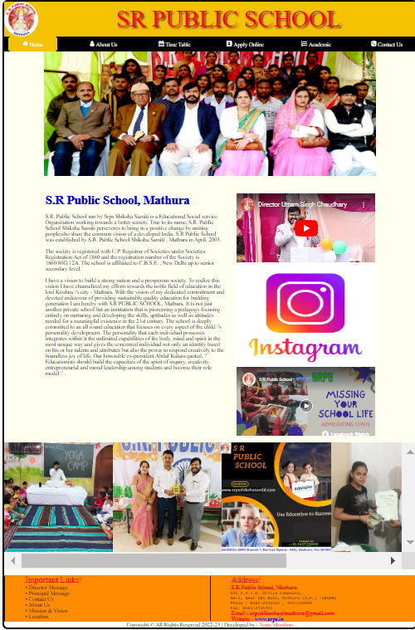
HOME PAGE

Slide 12
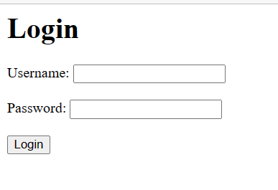
LOGIN PAGE

Slide 13
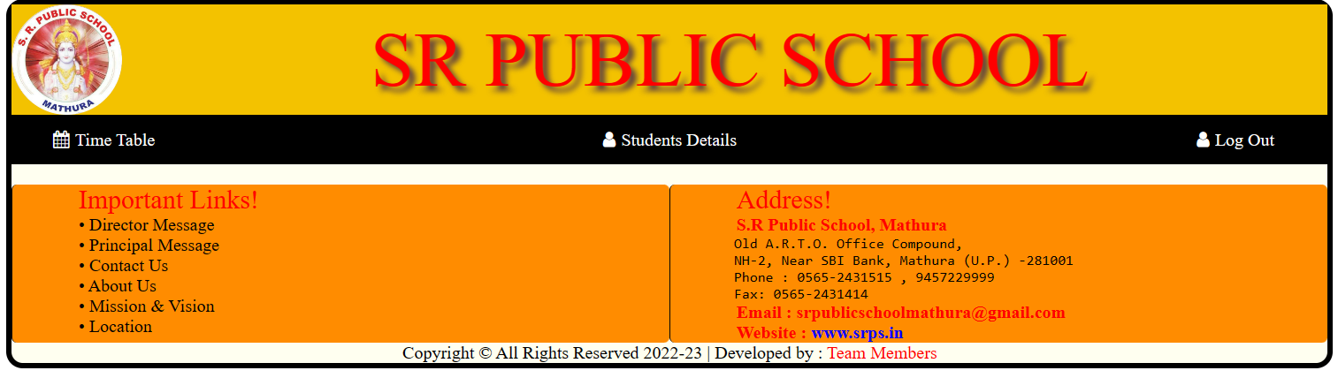
LOGOUT PAGEbjknkl8454

Slide 14
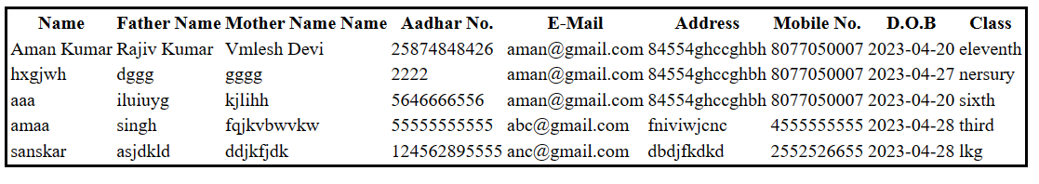
STUDENTS DETAILS PAGE

Slide 15
CONCLUSION
In conclusion, a school management system is a software application designed to manage the daily operations of a school. It provides a centralized platform for administrators, teachers, students, parents, and staff to manage various aspects of school operations, including admission and enrollment, attendance tracking, timetable scheduling, exam and result management, fee management, communication, library management, transportation management, and report generation and analysis.
Implementing a school management system can help schools improve their efficiency, communication, and student success. It allows schools to streamline their processes, reduce manual tasks, and provide stakeholders with real-time access to relevant information. Additionally, a school management system can improve the quality of education by helping schools track and analyze student progress, identify areas for improvement, and implement strategies for student success.
Overall, a school management system is an essential tool for modern schools, providing them with the technology needed to manage complex operations effectively and efficiently.
.

